Slide 1
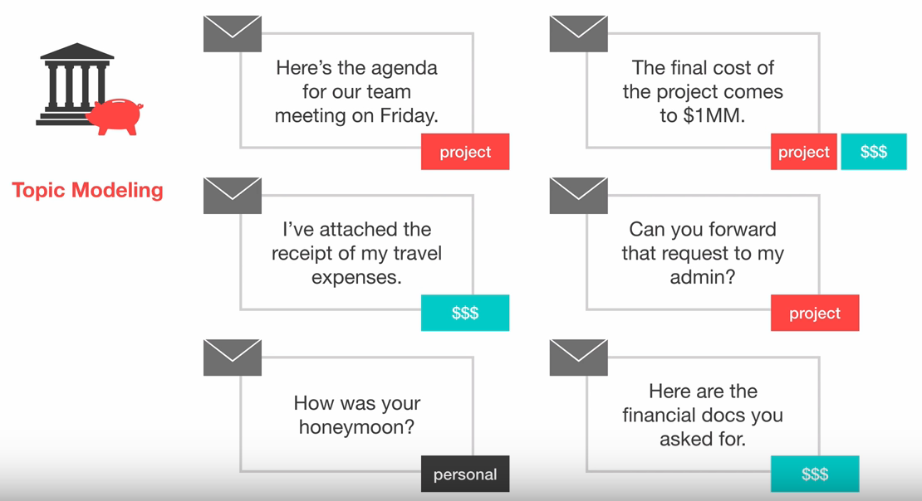
Week 5: APIs, Analyzing Twitter, and Topic Modeling
Geog4300: Shannon

Slide 2
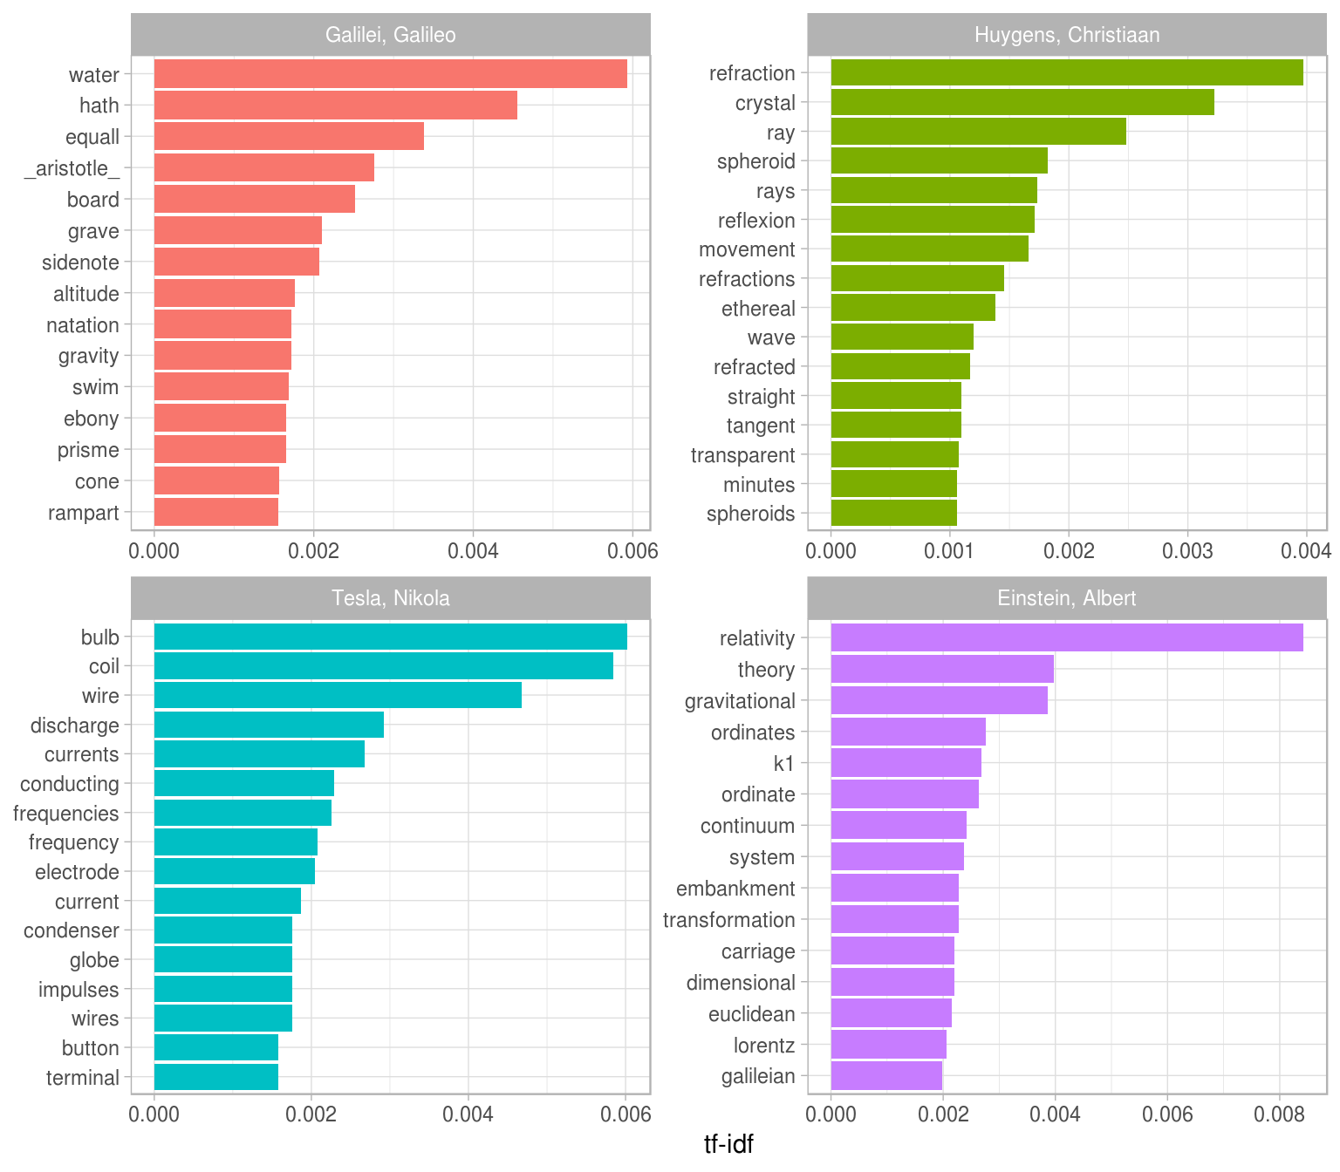
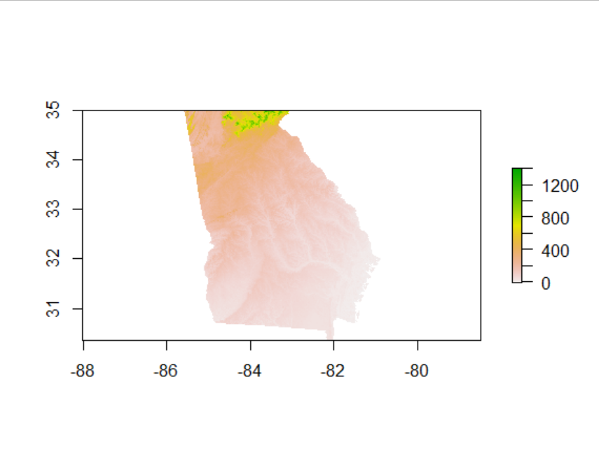
This week: Analyzing raster data, Text mining,
Sentiment analysis

Slide 3
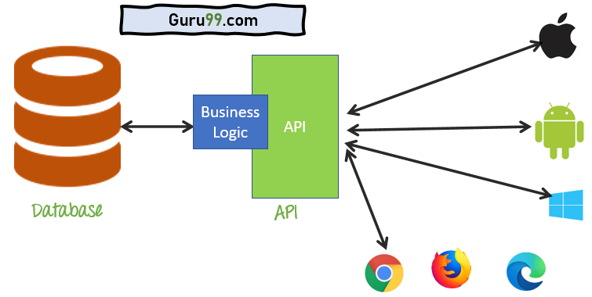
APIs: One main source of textual data

Slide 4


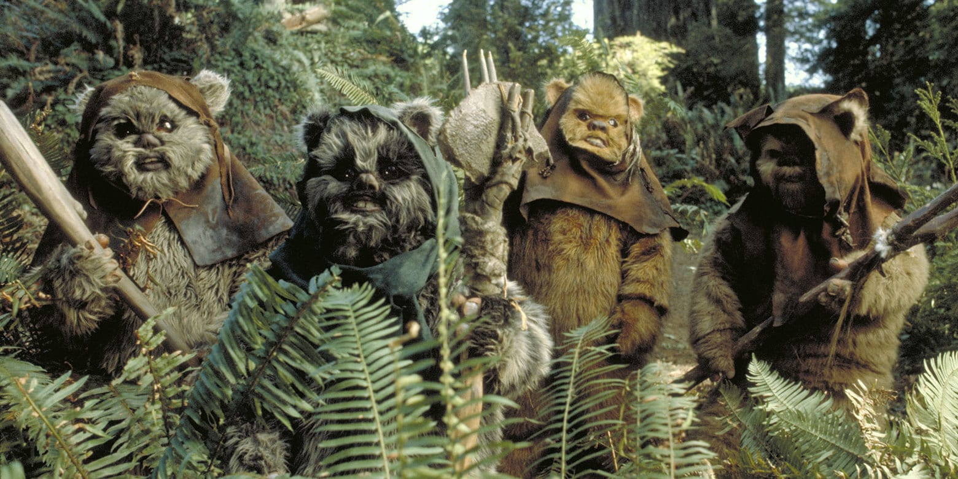
Easy example: SWAPI
https://swapi.dev/

Slide 5
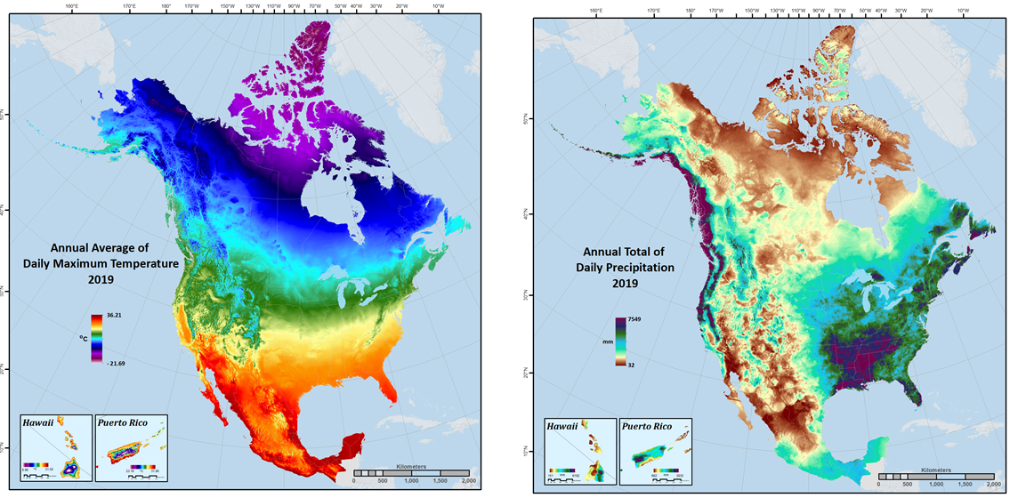
Another example: Daymet
https://daymet.ornl.gov/getdata
https://daymet.ornl.gov/single-pixel/api/data?lat=33.95&lon=-83.38&vars=tmax,tmin&start=2015-01-01&end=2020-12-31

Slide 6
Let’s look at other examples:
Twitter: https://developer.twitter.com/en/docs/twitter-api
Google Places: https://developers.google.com/maps/documentation/places/web-service/overview
Yelp fusion: https://www.yelp.com/fusion
What data are accessible through this API?
How do you get access to the API?
Is there a cost or any other restrictions?

Slide 7

Getting data from Twitter
In R, the rtweet package is one easy solution.
https://github.com/ropensci/rtweet
See the rtweet_demo script in the scripts folder on our course Github repo.

Slide 8
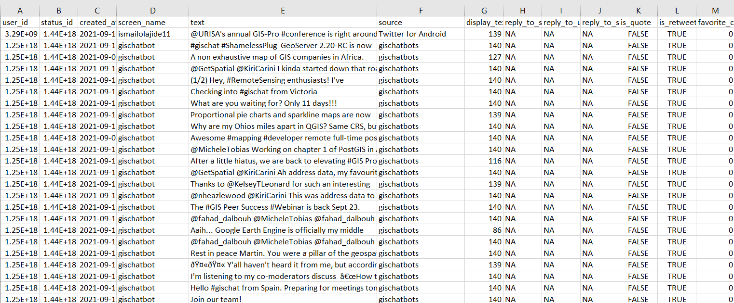
What questions could you answer with these data?
1,000 tweets with the hashtage #gischat from 9/15/21
gischat_tweets_2021_09_15 in our data folder

Slide 9
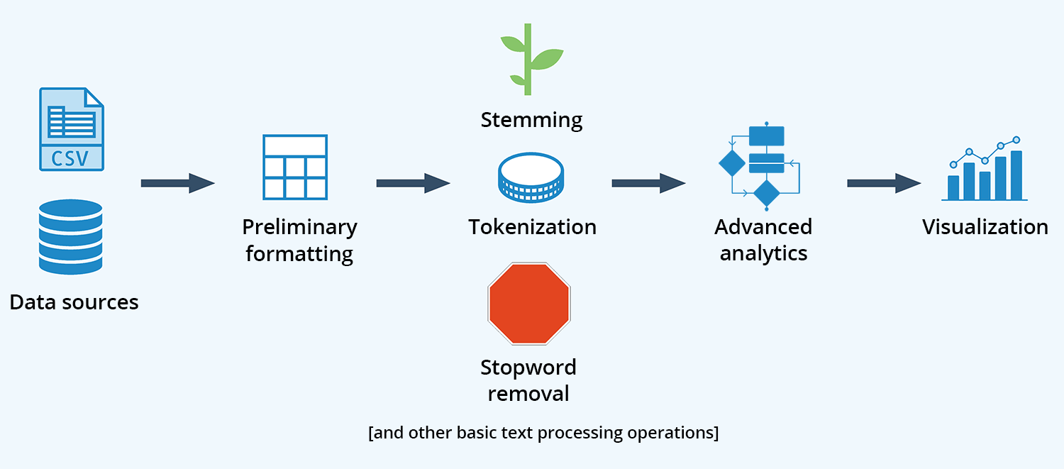
Text mining

Slide 10
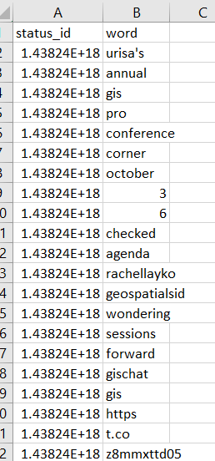
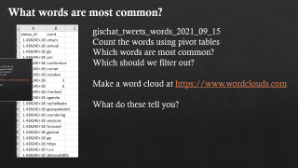
What words are most common?
gischat_tweets_words_2021_09_15
Count the words using pivot tables
Which words are most common?
Which should we filter out?
Make a word cloud at https://www.wordclouds.com
What do these tell you?

Slide 11
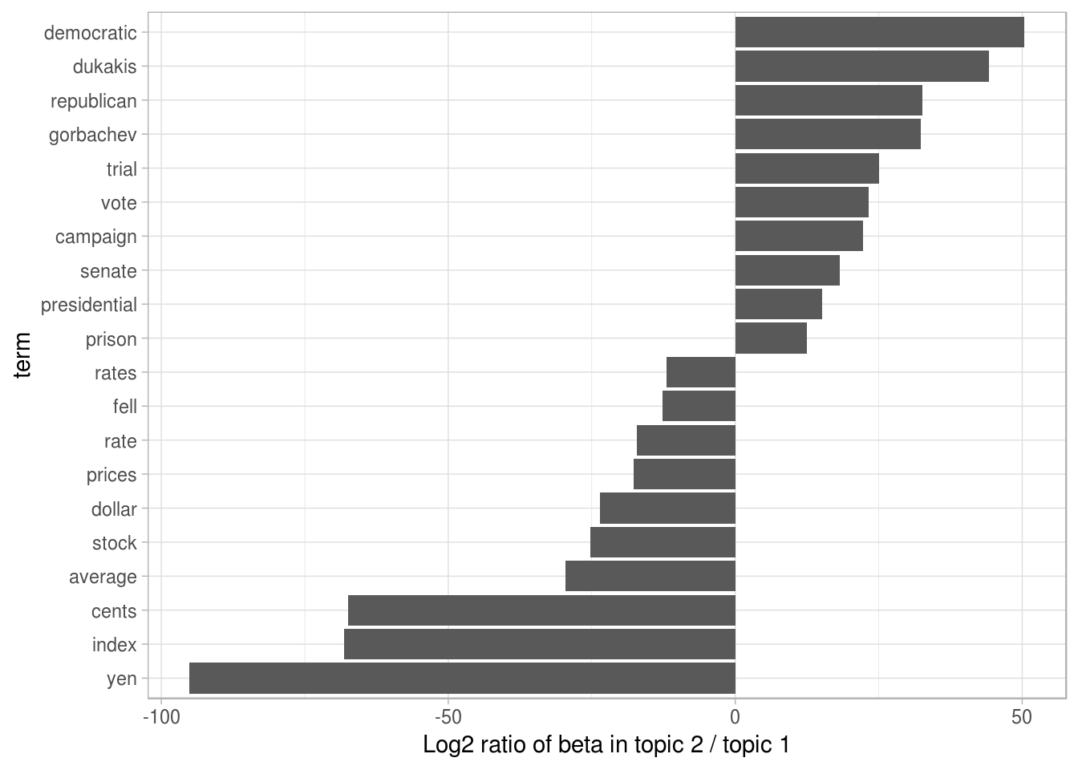
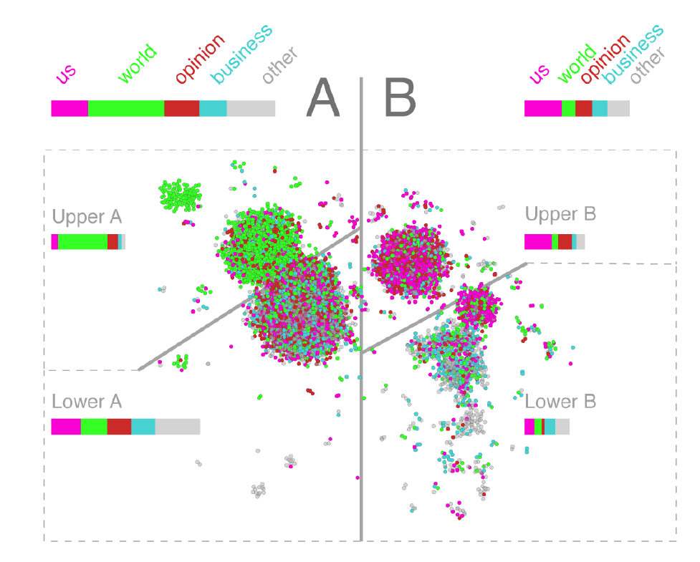
Topic modeling

Slide 12

https://www.youtube.com/watch?v=3mHy4OSyRf0

